Slide 1

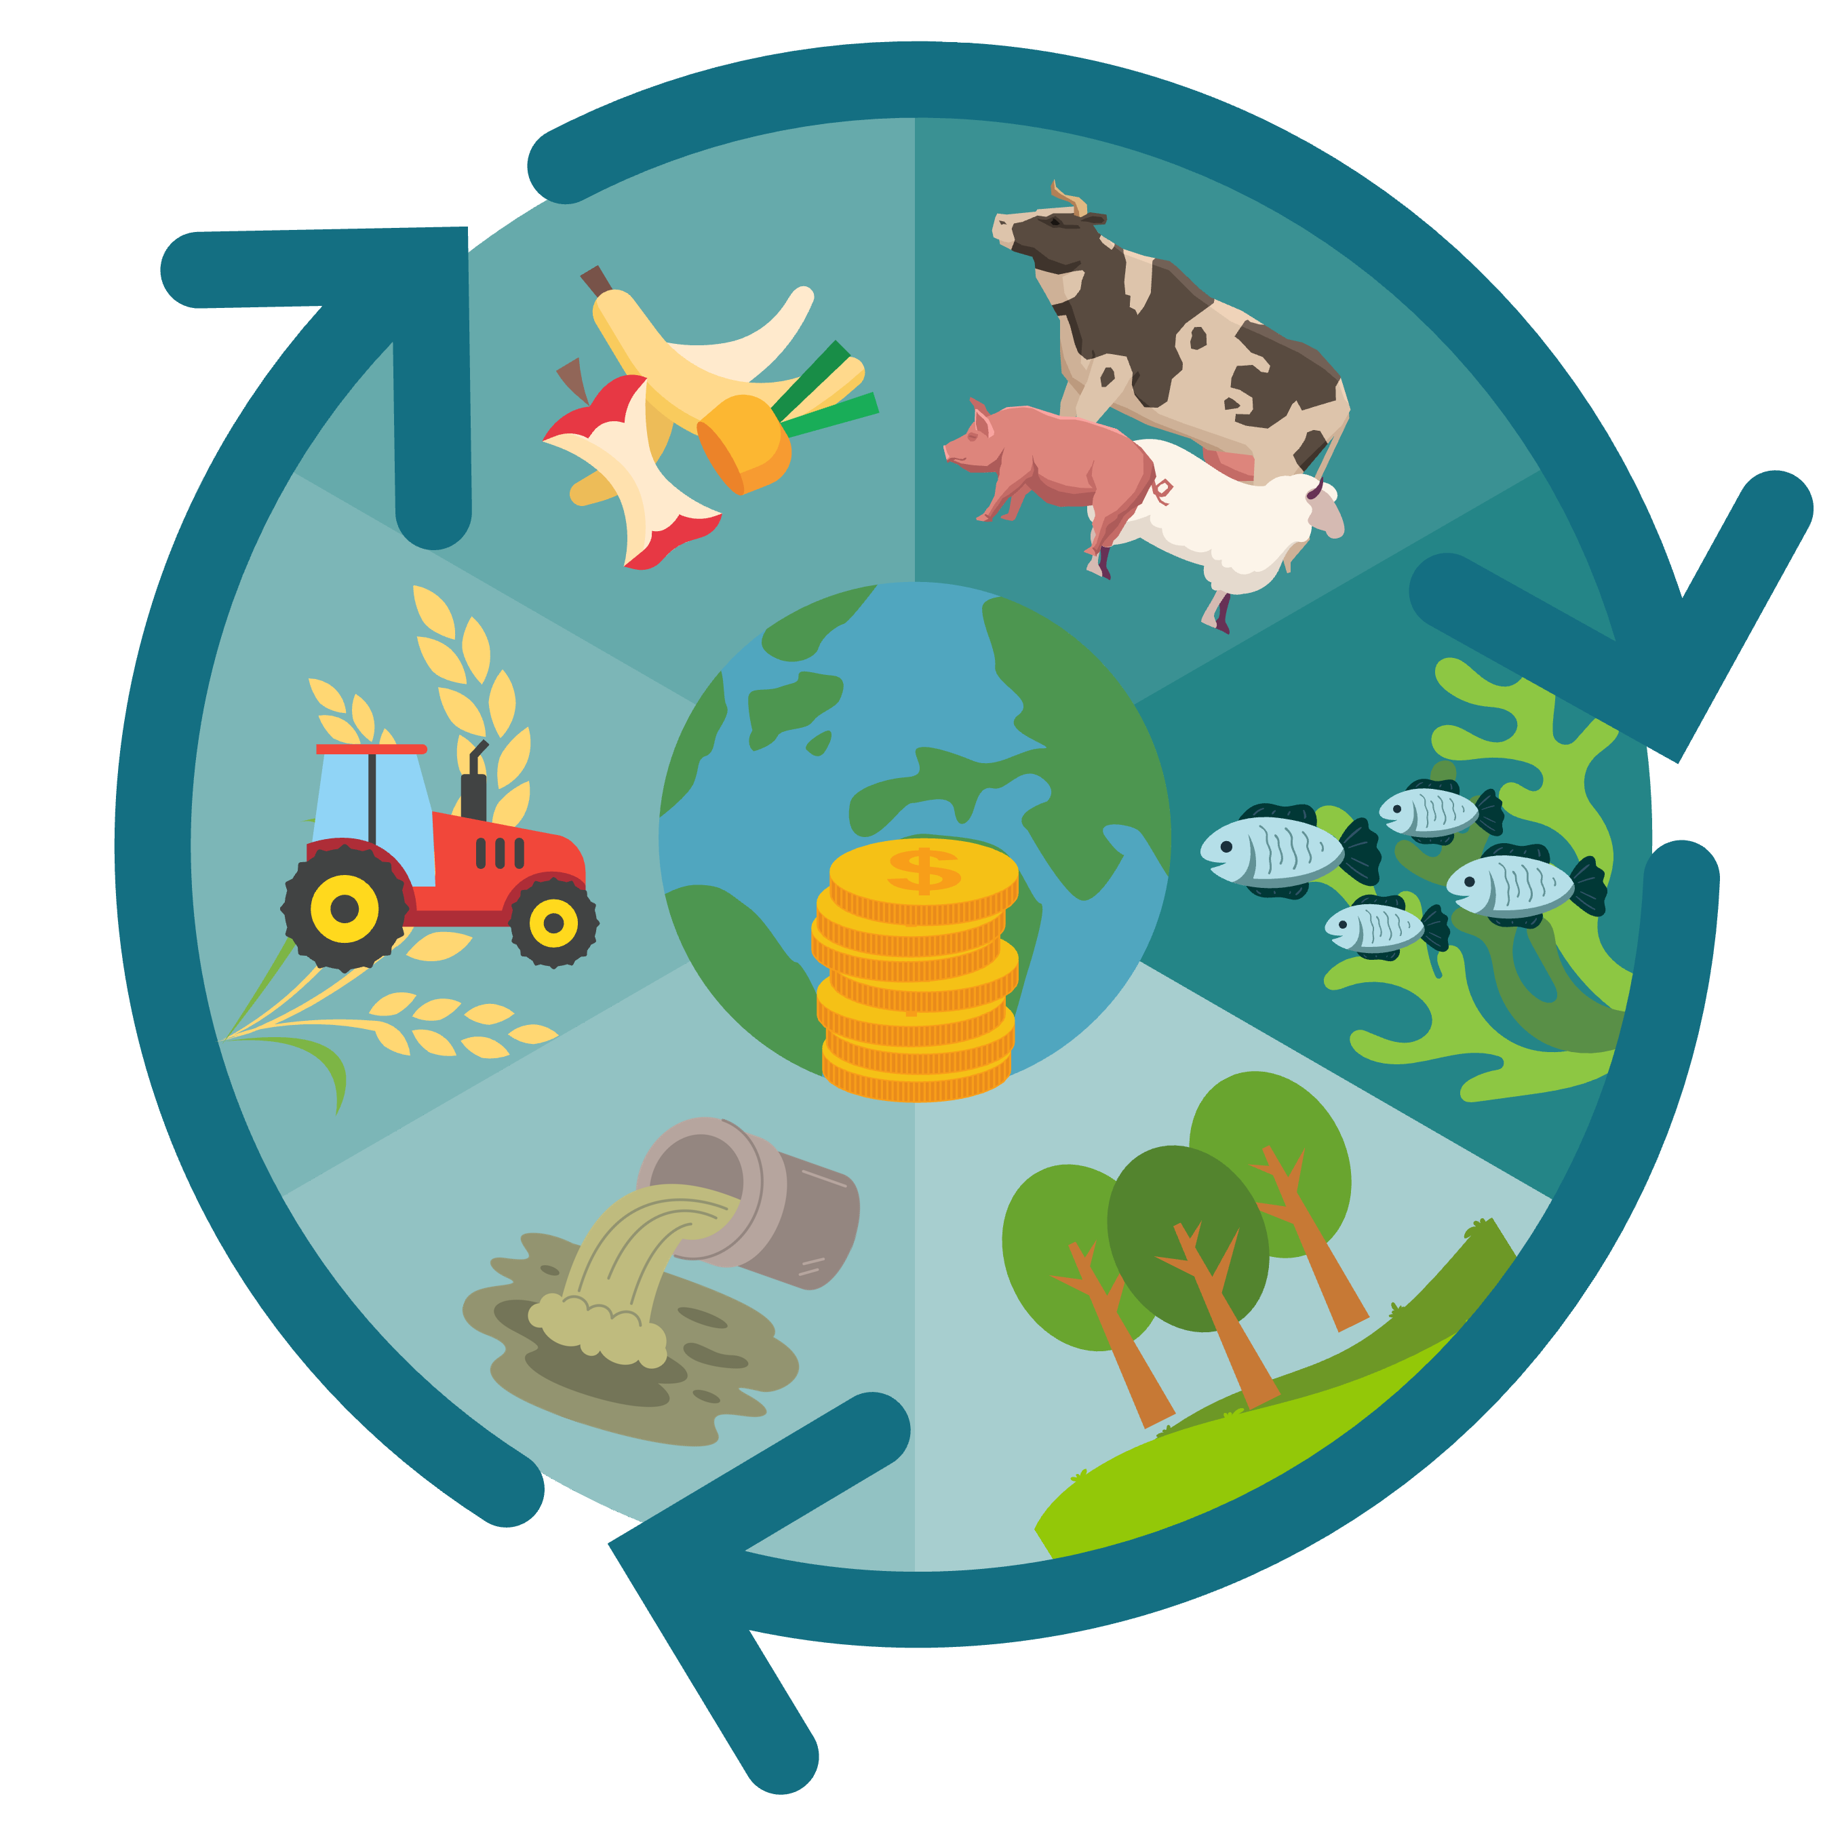
The Circular Bioeconomy
BIOØKONOMI

Slide 2
Learning Goals
What biogas and bioresidue is
How biomass can be turned into energy
The difference between the linear and circular bioeconomy
BIOØKONOMI
Uses of biogas and bioresidue
How nutrients can be recycled

Slide 3
What comes to mind when you hear the ”circular bioeconomy”?
BIOØKONOMI
Notes:
Bioeconomy is an economy where materials, chemicals and energy originate from renewable bio-based raw materials. In a circular economy, resources stay within society's cycle instead of becoming waste. On a whiteboard write the term ‘bioeconomy’ in the middle. Invite the students to think of different concepts, processes, activities that the term can involve. Write down the answers surrounding the term and create a “word cloud”. The link provides a video explanation for students and can be used as an introduction to the topic in classrooms. While the video is playing you can cross the words that the students came up with in the word cloud. Did you cross at least 6 words off in the cloud?

Slide 4

Biomass
Biomass refers to organic material, i.e. plants, animals and microorganisms, as well as waste products from these.
This includes everything from trees and crops to animal waste and microbial mass. Biomass is an important resource for humans, as it can be used as energy, food, feed, fiber and chemicals.

Slide 5
Linear vs Circular Bioeconomy
Biomass is used as raw material for the production of goods, energy or chemicals. After use, the biomass is thrown away as waste without being recycled or reused.
Biomass, products and nutrients are used, recovered and recycled to create a closed loop.

Slide 6

Agriculture
Key Principles:
Resource Efficiency: We aim to save and repurpose everything. Crop residues become valuable inputs, and nutrient recycling keeps soils healthy.
Biodiversity: Diverse cropping systems enhance resilience and support ecosystems.
Reducing Waste: Circular agriculture tackles waste at every stage.

Slide 7
Forestry
Historical Focus: Circularity:
Traditionally, forest management has centered around circularity—the practice of replanting after harvesting. This ensures a sustainable cycle of growth and regeneration.
Circular management aims to maintain forest health, biodiversity, and ecosystem services.
The New Frontier: Optimization in forestry to ensure even wider use of resources and waste less

Slide 8
Aquaculture
Untapped Marine Resources:
Coastal waters hide a treasure trove of low-trophic marine resources.
These organisms have a superpower: they filter nutrients from seawater.
Nutrient-Richness:
Low-trophic species are like nutritional powerhouses:
High-Quality Protein
Omega-3 Fatty Acids
Cellulose

Slide 9
Today’s topics
Biorefining: biogas and biofertilizer
Pyrolysis: biochar, bio-oil and syngas
Gassification
Protein extraction
Struvite extraction & Easy Mining
N2applied

Slide 10

Biorefining
Organic material → products and energy
Environmentally friendly use of plants, algae and waste
Chemical, termical, and physical processing
Results, ex: biochar, bioplastic, and vanilla flavour
Renewable sources, lower greenhouse gas emissions and amount of waste

Slide 11



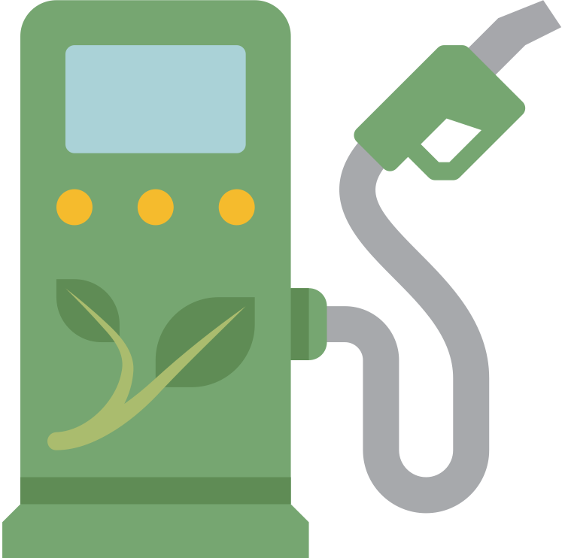

Renewable energy from organic material such as food waste and livestock manure
Biogas
Anaerobic decomposition in closed containers with microorganisms
Areas of use: thermal energy (heat), fuel, electricity
Example:
Trucks fueled by biogas
Notes:
Biogass: Energiløsning fra søppel, gjødsel og matrester
Organisk materiale i lukkede beholdere uten luft
Nedbrytning av organisk materiale av mikroorganismer
Biogassproduksjon: Metan, karbondioksid og vanndamp
Gjenbruk av farlige stoffer: Metan og karbondioksid fanges opp
Bruksområder: Varmeenergi, drivstoff til kjøretøy, elektrisitet
Viktig rolle i avfallshåndtering: 76% kildesortert matavfall til biogass (2020)
Bruk i byer som Oslo: Bussdrift på biogass for å redusere avfall og erstatte fossile brensler
Biogassproduksjon gir bonusproduktet: biogjødsel
Biogjødsel: Næringsrik gjødsel med karbon
Egnet for matproduksjon og karbonoppbygging i jord
Karbon viktig for jordkvalitet, næringskilde for mikroorganismer
Bidrar til fuktighet og forbedret jordstruktur
Flytende konsistens lik tynn husdyrgjødsel
Kan brukes med samme utstyr som tynn husdyrgjødsel
Miljøvennlig alternativ til kunstgjødsel uten skadelige kjemikalier
Opprettholder jordens helse

Slide 12
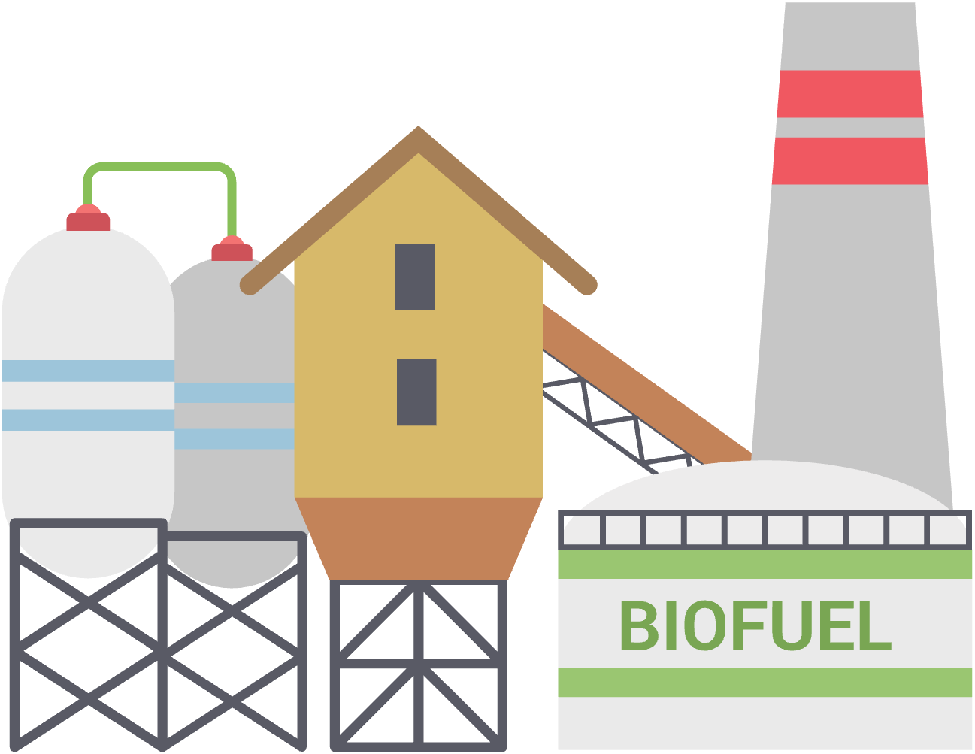


Biofertilizer
Nutritious fertilizer with important nutrients
Improves soil structure and increases carbon storage
Nutrient source for microorganisms and maintains soil health
Less odor compared to regular manure
Liquid consistency, easy spreading without re-adjustment
Biogass
Notes:
Biogass: Energiløsning fra søppel, gjødsel og matrester
Organisk materiale i lukkede beholdere uten luft
Nedbrytning av organisk materiale av mikroorganismer
Biogassproduksjon: Metan, karbondioksid og vanndamp
Gjenbruk av farlige stoffer: Metan og karbondioksid fanges opp
Bruksområder: Varmeenergi, drivstoff til kjøretøy, elektrisitet
Viktig rolle i avfallshåndtering: 76% kildesortert matavfall til biogass (2020)
Bruk i byer som Oslo: Bussdrift på biogass for å redusere avfall og erstatte fossile brensler
Biogassproduksjon gir bonusproduktet: biogjødsel
Biogjødsel: Næringsrik gjødsel med karbon
Egnet for matproduksjon og karbonoppbygging i jord
Karbon viktig for jordkvalitet, næringskilde for mikroorganismer
Bidrar til fuktighet og forbedret jordstruktur
Flytende konsistens lik tynn husdyrgjødsel
Kan brukes med samme utstyr som tynn husdyrgjødsel
Miljøvennlig alternativ til kunstgjødsel uten skadelige kjemikalier
Opprettholder jordens helse

Slide 13


  Efficient use of organic waste
  Creates new jobs and value creation
  Renewable resource that reduces dependence on non-sustainable alternatives
Dependance on sufficient access to raw materials
Potencial odor problems
Climatic conditions
High costs of investment in infrastructure
    Pros
Cons

Slide 14
  Efficiant use of organic waste
  Creates new jobs and value creation
  Renewable resource that reduces dependance on non-sustainable alternatives
Dependence on sufficient access to raw materials
Potential odor problems
Climatic conditions
High costs and investments in infrastructure
    Pros
Cons

Slide 15
Climate benefit
Climate benefit: Positive effects for the climate
100 percent - what does that mean?
Environmental climate benefits
Social climate benefits
Economic climate benefits

Slide 16
Climate benefit of biogas
The benefit of biogas replacing fossil energy carriers
The benefit of CO2 from upgrading biogas replacing fossil-based CO2
The benefit of bioresidue replacing mineral fertiliser
The benefit of waste and fertilizer resources being processed in biogas plants that have a lower climate impact than alternative processing
Climate benefit is expressed as a percentage. Investing in biogas can yield a climate benefit of over 100 percent. Example:
Imagine a vehicle emitting 100 tons of CO2 equivalents using regular gasoline. If we replace gasoline with biogas and reduce emissions by 100 tons of CO2 equivalents, we achieve 100 percent climate benefit. In other words, we’ve eliminated or reduced greenhouse gas emissions equivalent to the fossil fuel reference point.

Slide 17




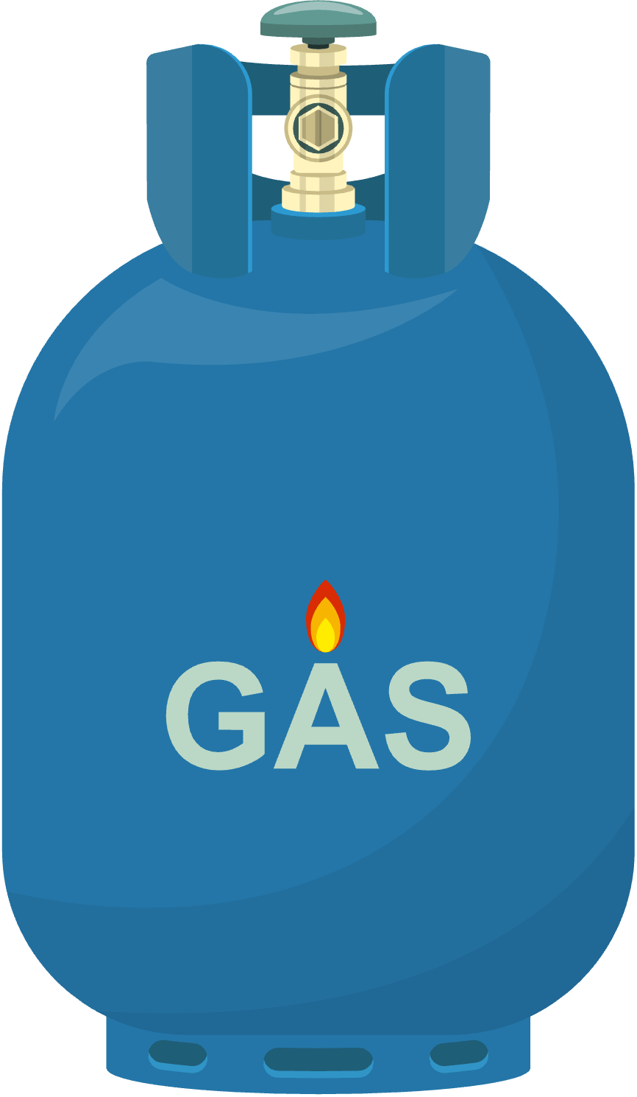
Pyrolysis
From biomass to valuable products
Prosess: Heating without oxygen 500-600°C
Products: biochar, biogas, bio oil
‘
3
500-600°C
2
1

Slide 18
Pyrolysis
Biochar
Porous, carbon-rich and stable material
Fra biomasse til verdifulle produkter
Prosess: Oppvarming uten oksygen 500-600°C
Nyttige produkter: Biokull, biogass, bio-olje
‘
3
500-600°C
2
Areas of use
Soil improvement
Carbon sequestration
Energy production
1

Slide 19
Pyrolysis
Biokull
Bio oil
Porøst, karbonrikt og stabilt materiale
Fra biomasse til verdifulle produkter
Prosess: Oppvarming uten oksygen 500-600°C
Nyttige produkter: Biokull, biogass, bio-olje
Contains tar, hydrocarbons and water
‘
3
500-600°C
Areas of use
Heating, power generation, fuel, cooking
2
Pros
Flexibility, energy efficiency and easy to integrate
Bruksområder
Jordforbedring
Karbonbinding
Energiproduksjon
1

Slide 20
Pyrolysis
Biokull
Syngas
Bio-olje
Porøst, karbonrikt og stabilt materiale
Contains methane, carbon monoxide, hydrogen, and some carbon dioxide and nitrogen
Fra biomasse til verdifulle produkter
Prosess: Oppvarming uten oksygen 500-600°C
Nyttige produkter: Biokull, biogass, bio-olje
Inneholder tjære, hydrokarboner og vann
‘
3
500-600°C
Bruksområder
Oppvarming, kraftproduksjon, drivstoff, matlaging
2
Fordeler
Fleksibilitet, energieffektiv og enkel å integrere
Bruksområder
Jordforbedring
Karbonbinding
Energiproduksjon
Areas of use
Natural gas replacement
Energy source
Raw material
1

Slide 21


  Utilization of overlooked resource
  Local production
  Environmentally friendly
    Pros
Financially challenging
Transport costs
Risik for deforestation
Cons

Slide 22
  Utilization of overlooked resourse
  Local production
  Environmentally friendly
    Pros
Financially challenging
Transport costs
Risk of deforestation
Cons

Slide 23
    Pros
  Ruduces emissions of hazardous substances
  Utilizes waste efficiently
  Recyclable materials
Gassification
Old technology
Turn fuel into gas
Heats at 800-1000°C
Forms syngas
Several materials can be gassified
‘
  Loq energy density
  Complicated process
    Cons
800 - 1000°C

Slide 24
    Pros
  Reduces emissions of hazardous substances
  Utilizes waste efficiently
  Recyclable metals
Gassification
Old technology
Turn fuel into gas
-Heats 800-1000°C
Forms syngas
Several materials can be gassified
‘
  Low energy density
  Complicated process
    Cons
800 - 1000°C

Slide 25
    Pros
  Reduces emissions of hazardous substances
  Utilizes waste efficiently
  Recyclable metals
Gassifisering
Gammel teknologi
Gjør brensel om til gass
Varmes på 800-1000°C
Danner syngass
Flere materialer kan gassifiseres
‘
  Low energy density
  Complicated process
    Cons
800 - 1000°C

Slide 26


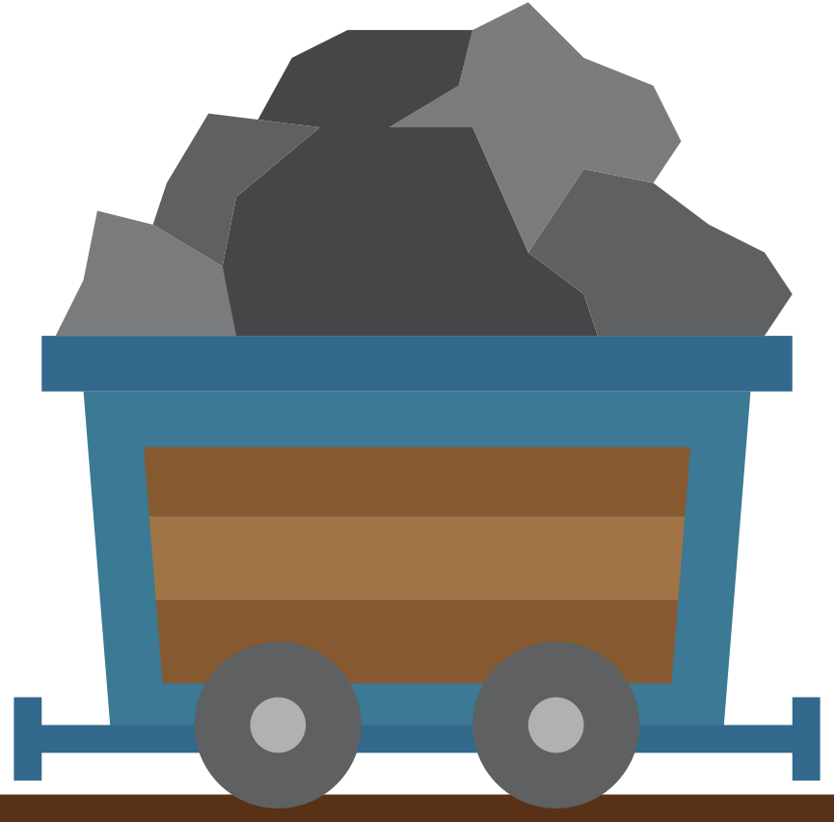
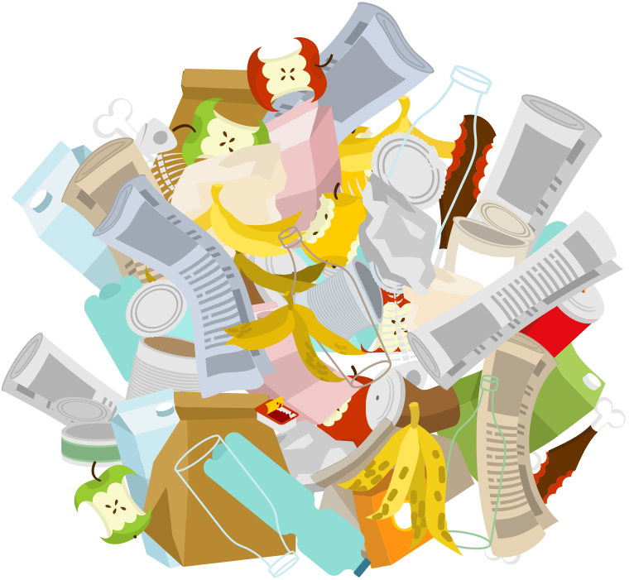
Pyrolysis
Gassification
Product
V S
Product
Temperature
Temperature
500 - 600°C
800 - 1000°C
Resources
Resources

Slide 27
Protein extraction
Raw materials
Grass, food waste, etc.
The process
Thermal hydrolysis
Extracting the protein Heating, pressing, liquid extraction
Uses
The protein liquid
The residual product

Slide 28
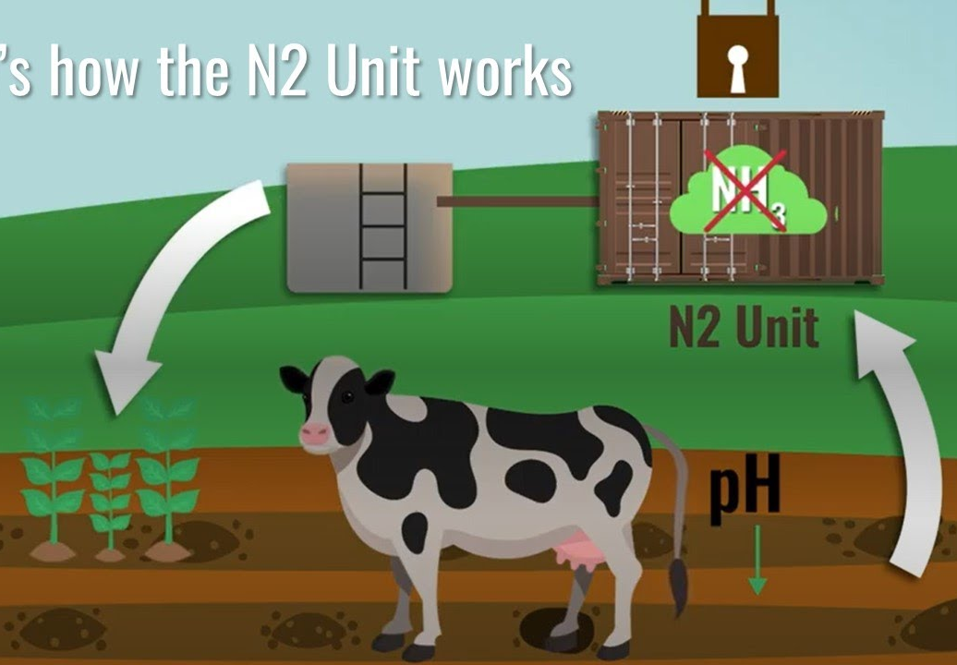
N2Applied technology reduces nitrogen oxide emissions
Air nitrogen → fertilizer
Produces fertilizer locally → reduces transport
N2Applied

Slide 29

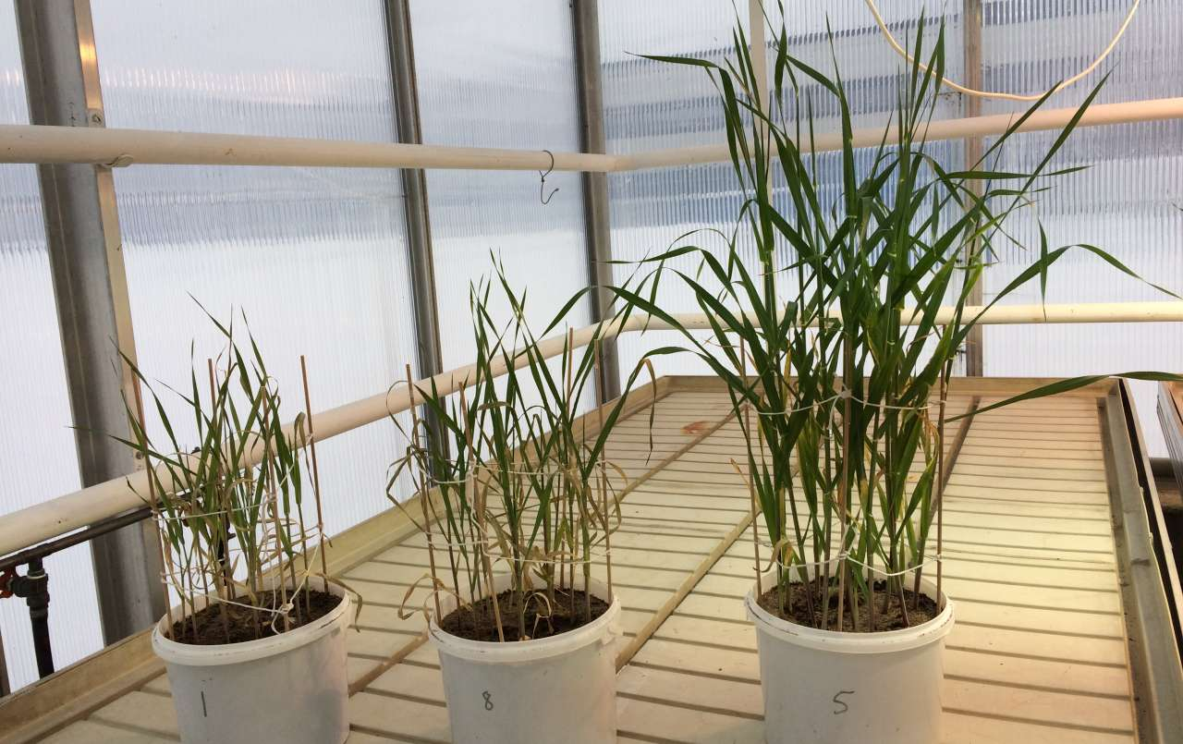



Struvite extraction
Struvite
Problem
Struvite extraction
Fertilizer
Phosphorus deficiency

Slide 30
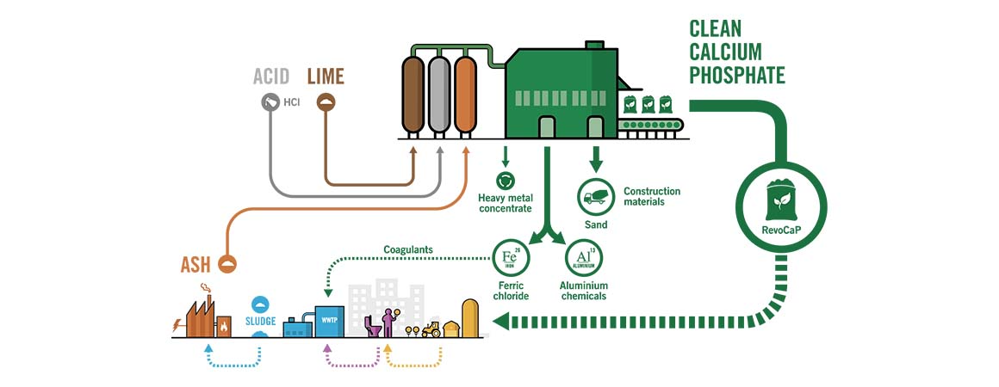
Extraction of phosphorus from sewage sludge
Up to 90% phosphorus recovery
Pros:
Waste as a resource
Avoids toxic metals from mining
Easymining
Ash2®Phos technology

Slide 31
More products
Bioplastics
Starch, a common component of many agricultural residues, can be extracted and processed to produce biodegradable plastics. The resulting bioplastic is not only biodegradable but also has a significantly lower carbon footprint compared to conventional plastics.
Sustainable Animal Feed
Grass protein concentrate is used as an ingredient in animal feeds, both wet and dry. It replaces soy and contributes to regional sustainability.
Fibers
Crop residues like straw, husks, and stalks are rich in cellulose, so these can be used for fiber, for example in textiles.
BIOØKONOMI
Pharmaceuticals
Many types of agricultural waste, such as fruit peels, seed husks, and crop residues, contain bioactive compounds that have potential uses in pharmaceutical and nutraceutical products.

Slide 32
The EU Green Deal – what is it?
Let’s watch an explanatory video
Bioeconomy
and Society
The Paris Agreement:
A treaty combating climate change. It aims to limit global temperature rise to well below 2°C above pre-industrial levels. Every signatory country works toward agreed-upon goals. For example, Sweden pledge to become carbon-neutral (have net-0 emissions) by 2045. Finland is one of Europe’s most ambitious countries, wanting to achieve climate neutrality by 2035. (Ministry of Foreign Affairs in Finland). Almost the entire world is working towards achieving climate neutrality by 2050

Slide 33
Did you know our schools also work with other partners in the EU to build a circular bioeconomy for the future?
Find out more:
Green Valleys- extracting green protein for animal feed
Biogas
BREC
Bioeconomy
and Society
Imagine it is 2030 and you have your own business in the green sector. What are you prepared to do to contribute to the goals? Perhaps produce renewable energy? Work with researchers to test new innovative technologies? Collect your waste to be later transformed into new products? Plant a garden that give shelter and food to pollinators?

Slide 34
Thank you for your attention and engagement

